Slide 1
BMD ENG 301Quantitative Systems Physiology (Nervous System)
Midterm Review
2022_v3
Professor Malcolm A. MacIver

Slide 2
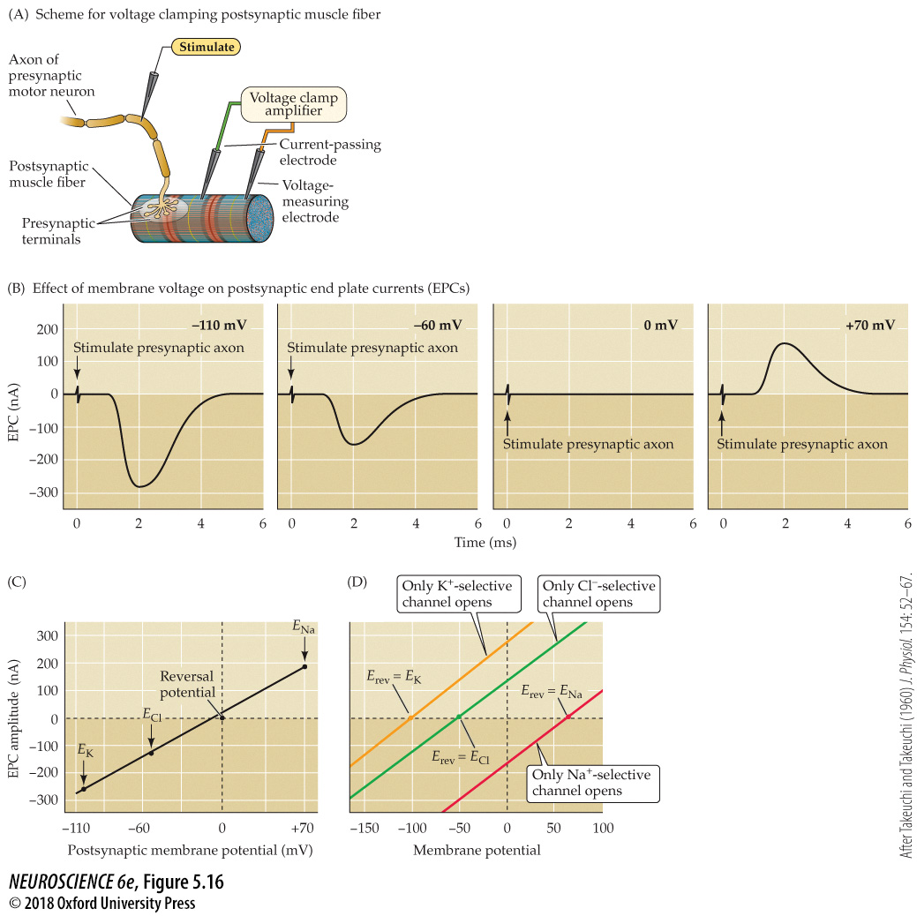
Influence of the postsynaptic membrane potential on end plate currents
Notes:
FIGURE 5.16 Influence of the postsynaptic membrane potential on end plate currents. (A) A postsynaptic muscle fiber is voltage clamped using two electrodes, while the presynaptic neuron is electrically stimulated to cause the release of ACh from presynaptic terminals. This experimental arrangement allows the recording of EPCs produced by ACh. (B) Amplitude and time course of EPCs generated by stimulating the presynaptic motor neuron while the postsynaptic cell is voltage clamped at four different membrane potentials. (C) The relationship between the peak amplitude of EPCs and postsynaptic membrane potential is nearly linear, with a reversal potential (the voltage at which the direction of the current changes from inward to outward) close to 0 mV. Also indicated on this graph are the equilibrium potentials of Na⁺, K⁺, and Cl– ions. (D) The identity of the ions permeating postsynaptic receptors is revealed by the reversal potential (E_{rev}). Activation of postsynaptic channels permeable only to K⁺ (yellow) results in currents reversing at E_{K}, near –100 mV, while activation of postsynaptic Na⁺ channels results in currents reversing at E_{Na}, near +70 mV (red). Cl–-selective currents reverse at E_{Cl}, near –50 mV (green). (A–C after Takeuchi and Takeuchi, 1960.)

Slide 3
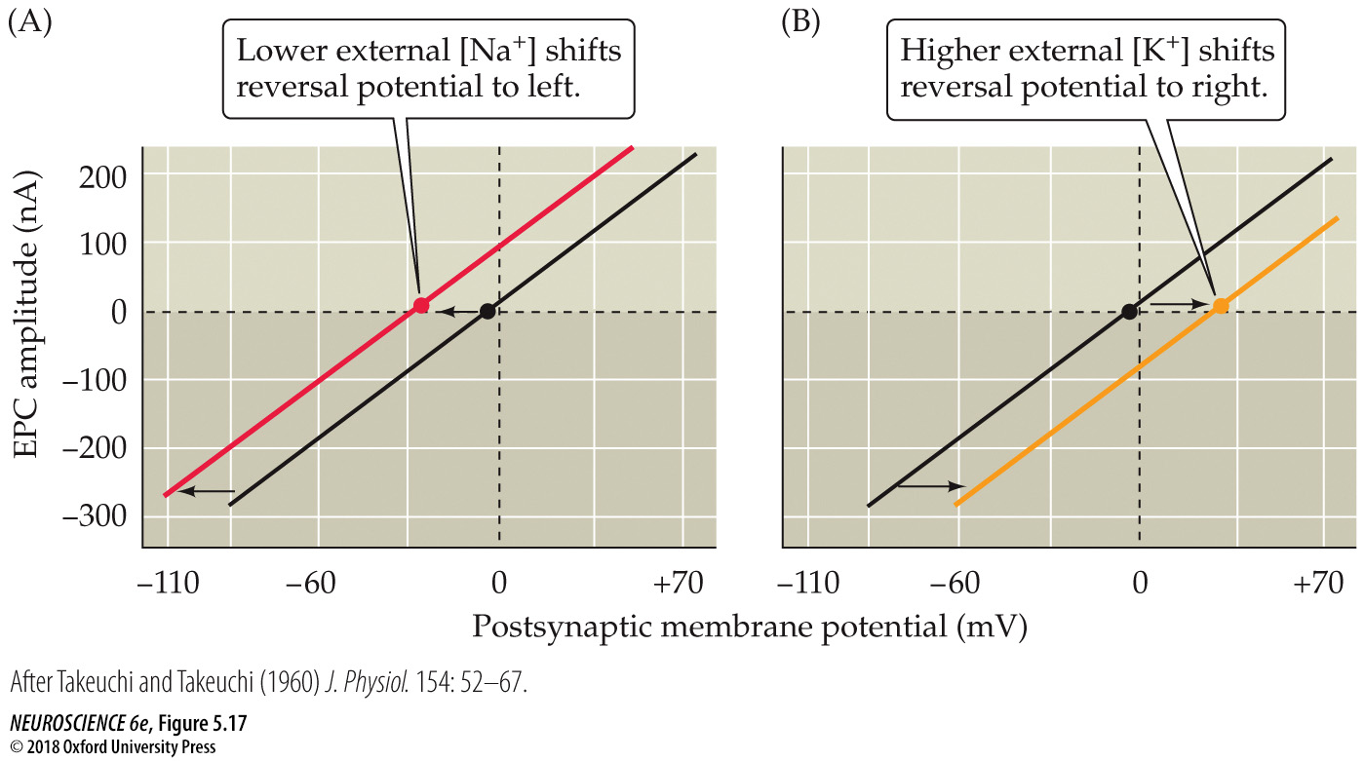
Reversal potential of the end plate current changes when ion gradients change
Notes:
FIGURE 5.17 Reversal potential of the end plate current changes when ion gradients change. (A) Lowering the external Na⁺ concentration causes EPCs to reverse at more negative potentials. (B) Raising the external K⁺ concentration makes the reversal potential more positive. (After Takeuchi and Takeuchi, 1960.)

Slide 4
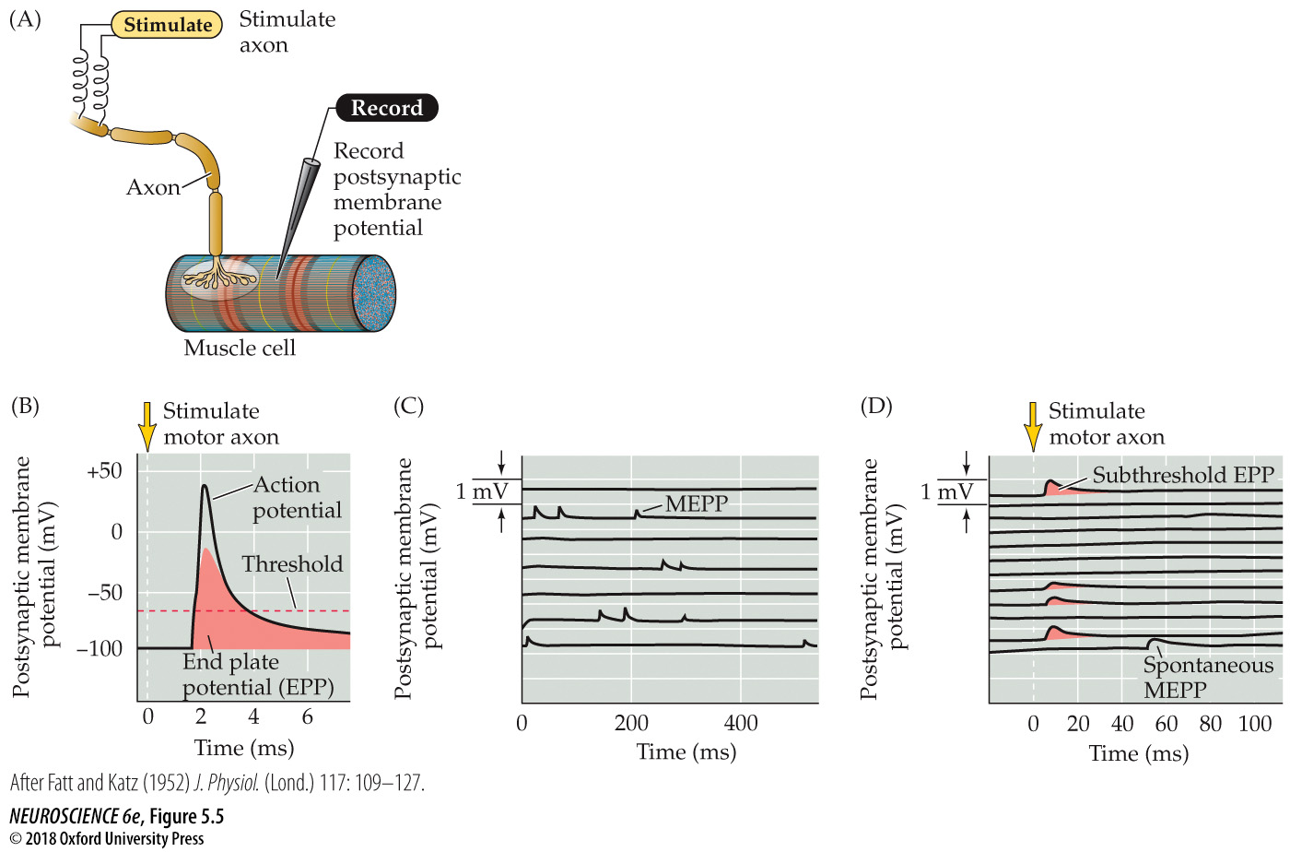
FIGURE 5.5 Synaptic transmission at the neuromuscular junction
Notes:
FIGURE 5.5 Synaptic transmission at the neuromuscular junction. (A) Experimental arrangement: The axon of the motor neuron innervating the muscle fiber is stimulated with an extracellular electrode, while an intracellular microelectrode is inserted into the postsynaptic muscle cell to record its electrical responses. (B) End plate potentials (shaded area) evoked by stimulation of a motor neuron are normally above threshold and therefore produce an action potential in the postsynaptic muscle cell. (C) Spontaneous miniature EPPs (MEPPs) occur in the absence of presynaptic stimulation. (D) When the neuromuscular junction is bathed in a solution that has a low concentration of Ca²⁺, stimulating the motor neuron evokes EPPs whose amplitudes are reduced to about the size of MEPPs. (After Fatt and Katz, 1952.)

Slide 5
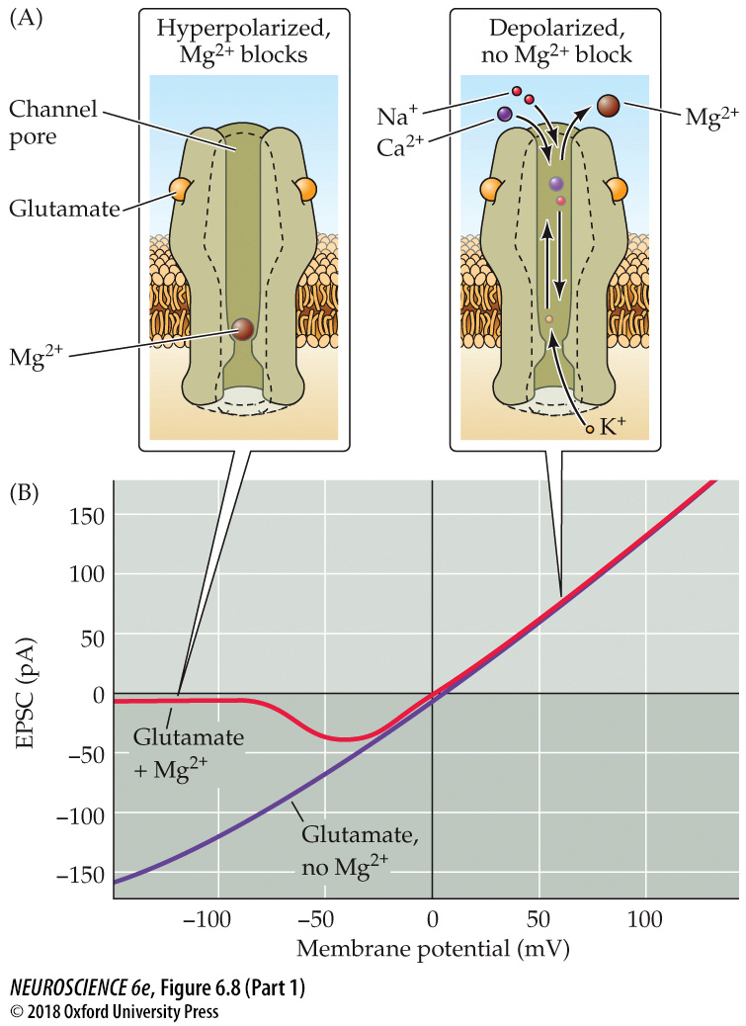
FIGURE 6.8 Function and structure of the NMDA receptor (Part 1)
Notes:
FIGURE 6.8 Function and structure of the NMDA receptor. (A) Voltage-dependent block of the NMDA receptor pore by Mg²⁺. At hyperpolarized potentials, Mg²⁺ resides within the channel pore and blocks it (left). Depolarization of the membrane potential pushes Mg²⁺ out of the pore, so that current can flow through the NMDA receptor. (B) Voltage dependence of current flowing through NMDA receptors activated by glutamate. In the presence of Mg²⁺ (red), Mg²⁺ block of the channel pore prevents current flow at hyperpolarized membrane potentials. If extracellular Mg²⁺ is removed, there is no block of the channel pore. (C–E) Crystallographic structure of the NMDA receptor. Each of the four subunits is indicated in a different color: GluN1 subunits are orange and yellow, GluN2 subunits cyan and purple. (C) The structure of the NMDA receptor is similar to that of the AMPA receptor, with an amino-terminal domain, ligand-binding domain, transmembrane domain, and carboxyl-terminal domain. The ligand-binding domain of GluN2A binds to glutamate (green spheres), while the ligand-binding domain of GluN1 binds to the co-agonist, glycine (green spheres). (D) Rotating the receptor 90 degrees reveals the location of the putative binding site for Ca²⁺. (E) Close-up view of the putative Ca²⁺ binding site (red and green mesh) in the extracellular vestibule of the receptor. (F) Model for gating of NMDA receptors. Proposed movements (arrows) of the amino-terminal domain and ligand-binding domain regions of the receptor when bound to antagonists, such as DCKA and D-APV (left), or agonists (glycine and glutamate, right). (C–E from Karakas and Furukawa, 2014; F from Zhu et al., 2016.)

Slide 6
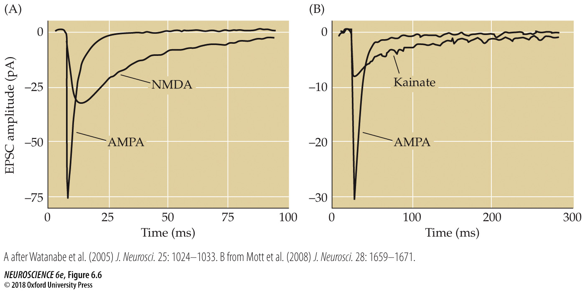
FIGURE 6.6 Postsynaptic responses mediated by ionotropic glutamate receptors
Notes:
FIGURE 6.6 Postsynaptic responses mediated by ionotropic glutamate receptors. (A) Contributions of AMPA and NMDA receptors to EPSCs at a synapse between a presynaptic pyramidal cell and a postsynaptic interneuron in the visual cortex. Blocking NMDA receptors reveals a large and fast EPSC mediated by AMPA receptors, while blocking AMPA receptors reveals a slower EPSC component mediated by NMDA receptors. (B) Contributions of AMPA and kainate receptors to miniature EPSCs at the excitatory synapse formed between mossy fibers and CA3 pyramidal cells in the hippocampus. Pharmacological antagonists reveal that the component of EPSCs mediated by AMPA receptors is larger and decays faster than that mediated by kainate receptors. (A after Watanabe et al., 2005; B from Mott et al., 2008.)

Slide 7
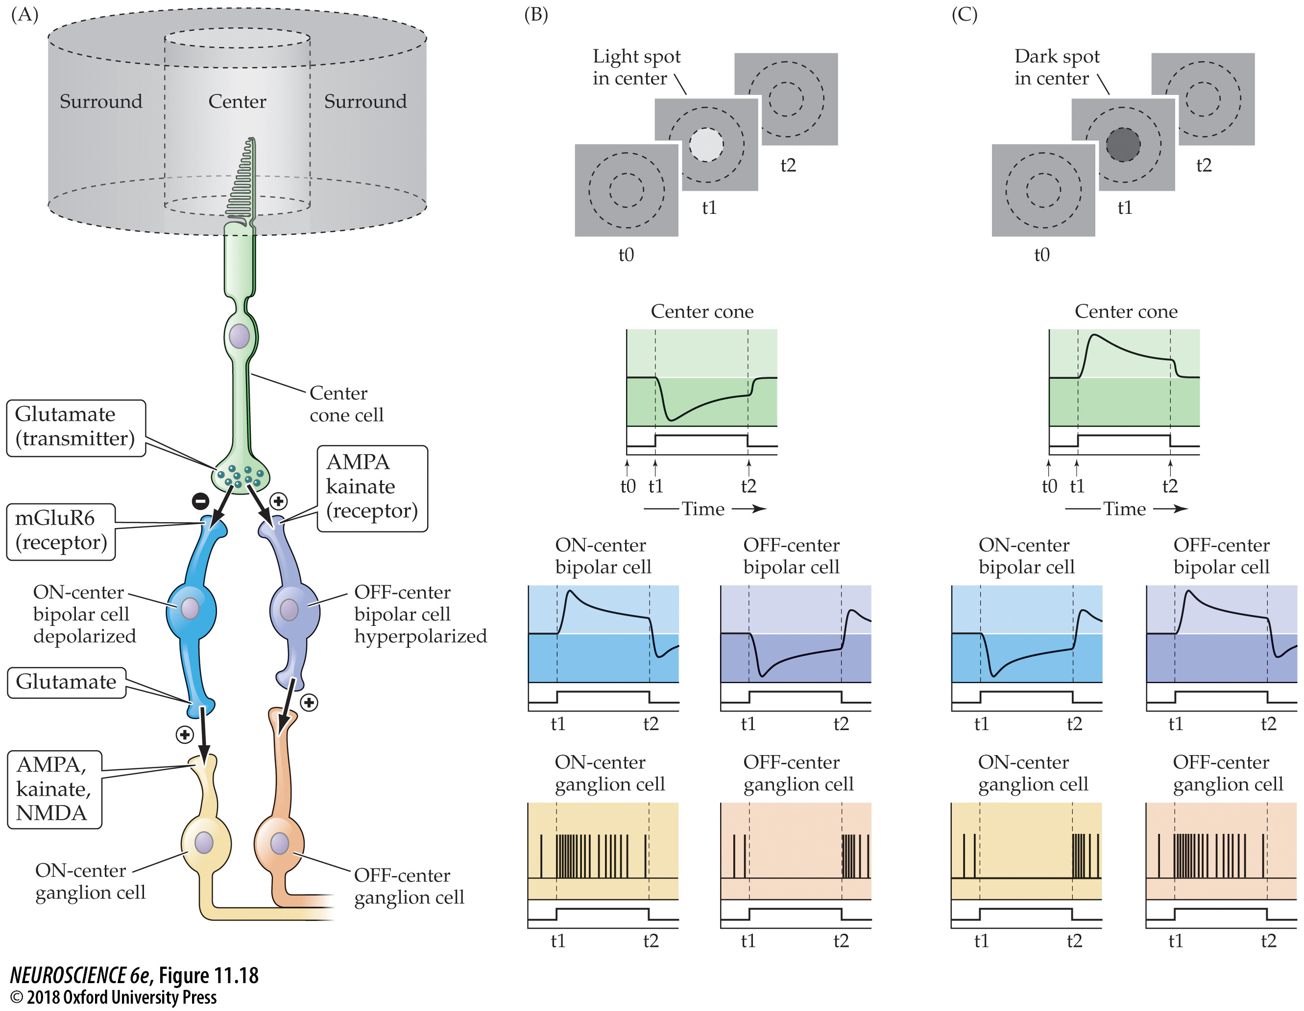
FIGURE 11.18 Circuitry responsible for generating receptive field center responses of retinal ganglion cells
Notes:
FIGURE 11.18 Circuitry responsible for generating receptive field center responses of retinal ganglion cells. (A) Functional anatomy of cone inputs to the center of a ganglion cell receptive field. A plus indicates a sign-conserving synapse; a minus represents a sign-inverting synapse. (B) Responses of the various cell types to the presentation of a light spot in the center of the ganglion cell receptive field. (C) Responses of the various cell types to the presentation of a dark spot in the center of the ganglion cell receptive field.

Slide 8
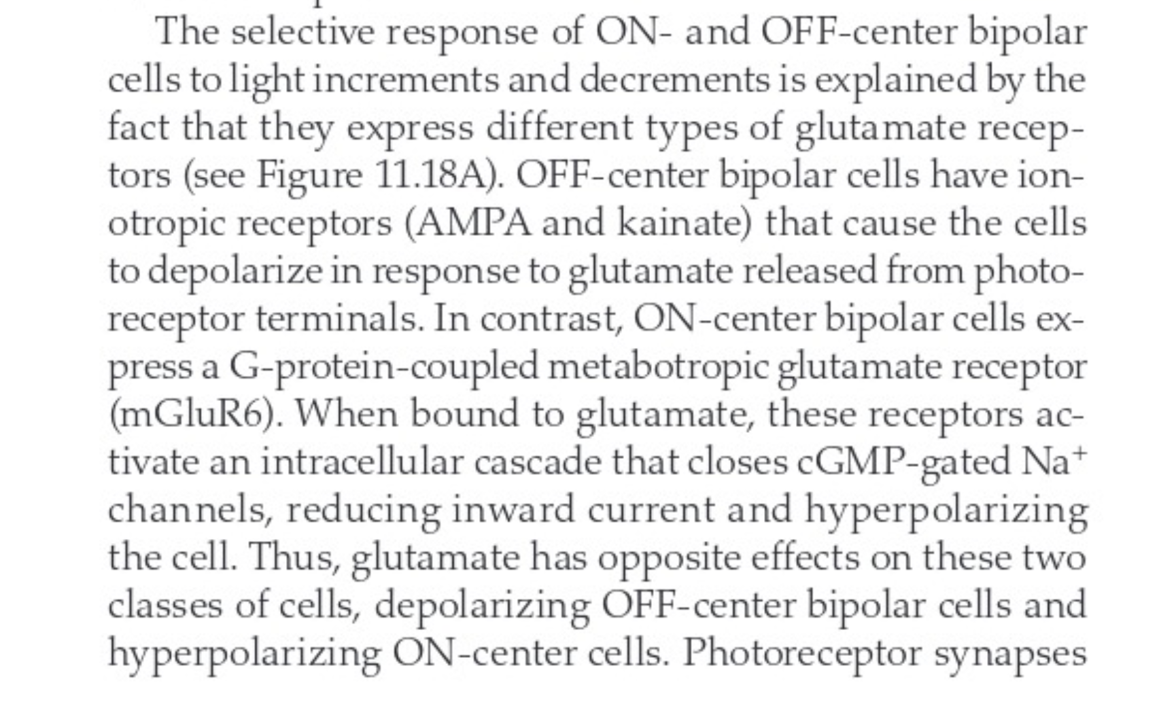
Chap 11, p. 253:

Slide 9
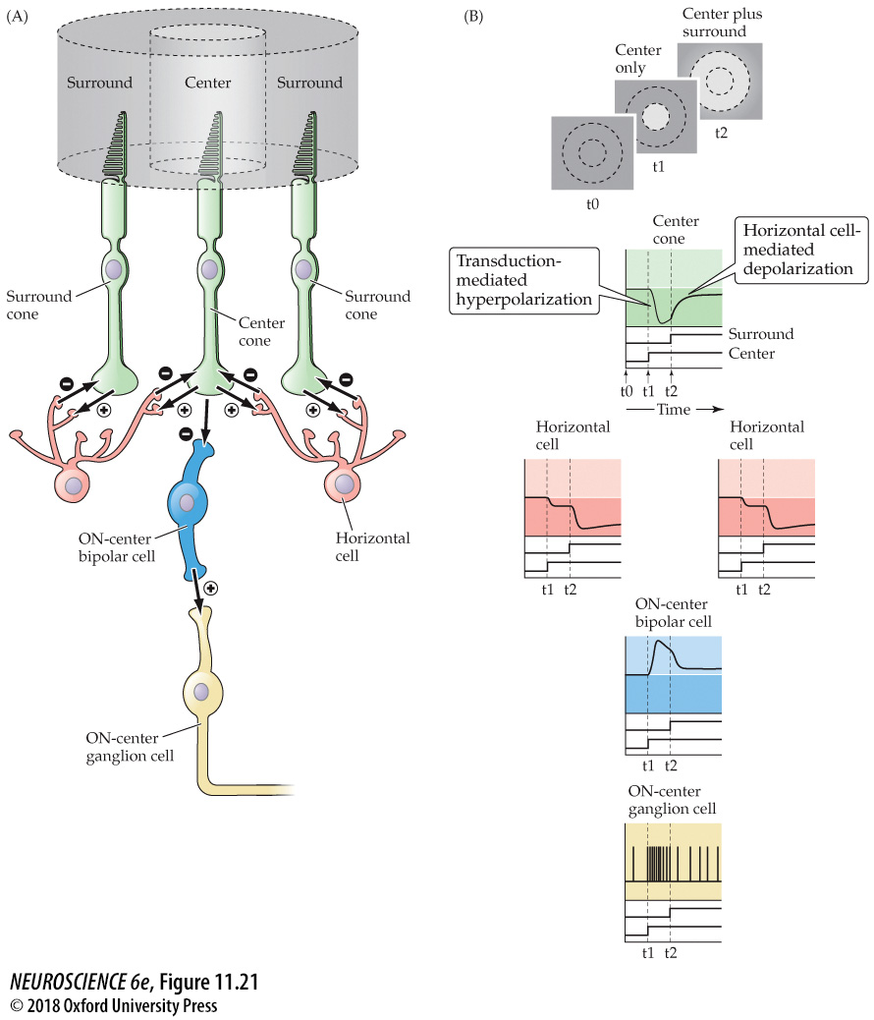

Slide 10
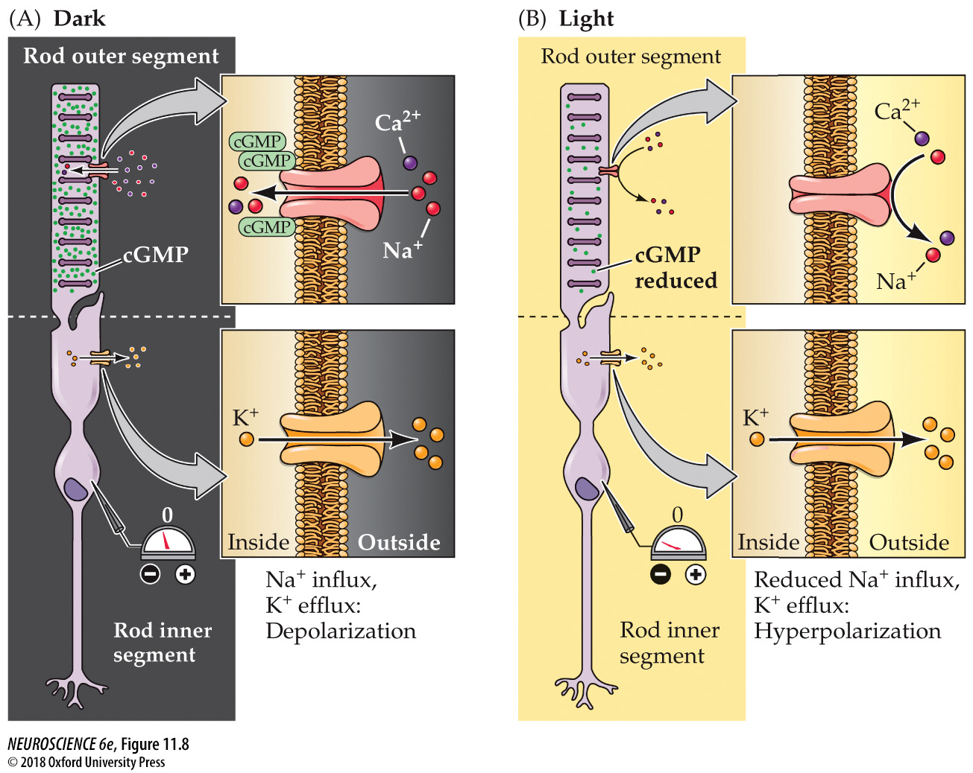
FIGURE 11.8 Cyclic GMP–gated channels and light-induced changes in the electrical activity of photoreceptors
Notes:
FIGURE 11.8 Cyclic GMP–gated channels and light-induced changes in the electrical activity of photoreceptors. This simplified diagram shows a rod, but the same scheme applies to cones. (A) In the dark, cGMP levels in the outer segment membrane are high; cGMP binds to the Na⁺-permeable channels in the membrane, keeping them open and allowing sodium and other cations to enter, thus depolarizing the cell. (B) Absorption of photons leads to a decrease in cGMP levels, closing the cation channels and resulting in receptor hyperpolarization.

Slide 11
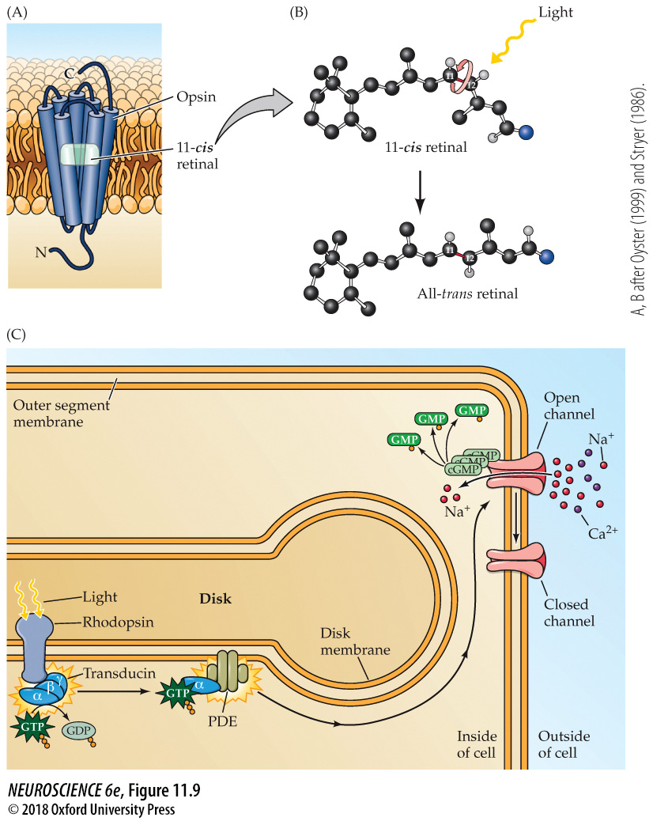
FIGURE 11.9 Phototransduction in rod photoreceptors
Notes:
FIGURE 11.9 Phototransduction in rod photoreceptors. (A) Rhodopsin resides in the disk membrane of the photoreceptor outer segment. The seven transmembrane domains of the opsin molecule enclose the light-sensitive retinal molecule. (B) Absorption of a photon of light by retinal leads to a change in configuration from the 11-cis to the all-trans isomer. (C) The second messenger cascade of phototransduction. The change in the retinal isomer activates transducin, which in turn activates a phosphodiesterase (PDE). The PDE then hydrolyzes cGMP, reducing its concentration in the outer segment and leading to the closure of channels in the outer segment membrane. (A, B after Oyster, 1999 and Stryer, 1986.)

Slide 12
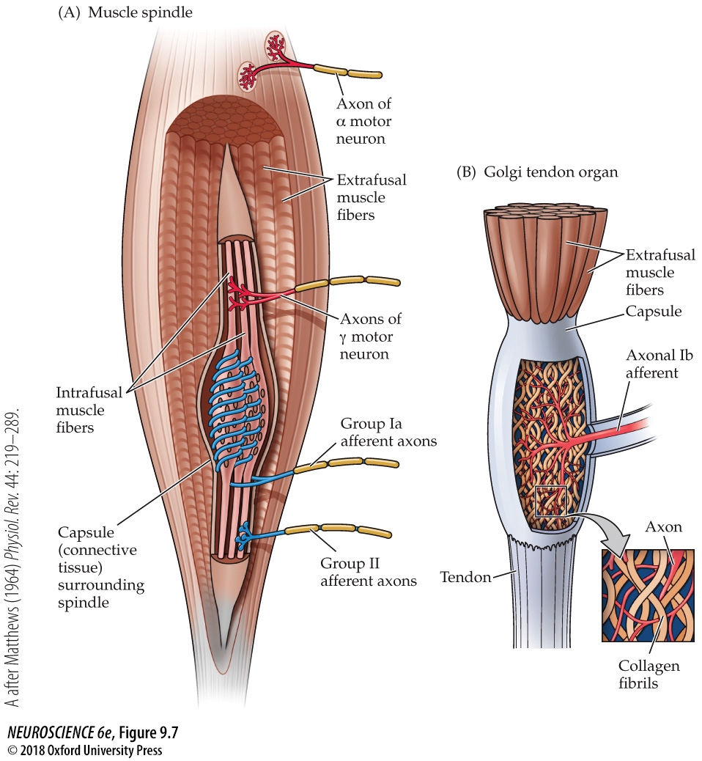
Muscle spindle
Changes in muscle contraction – steady change and rate of change
Golgi tendon organ
Change in muscle tension (force)

Slide 13
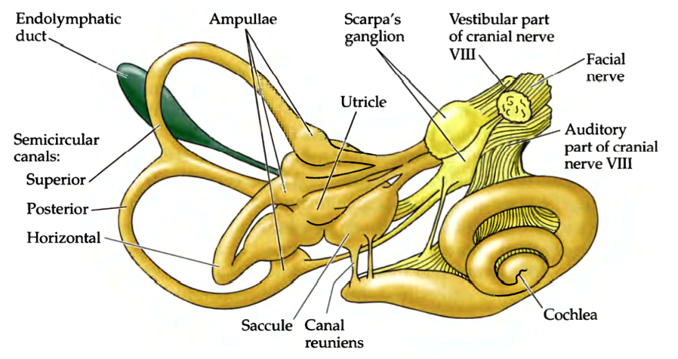
Inner Ear
Vestibular reception
Auditory Reception

Slide 14
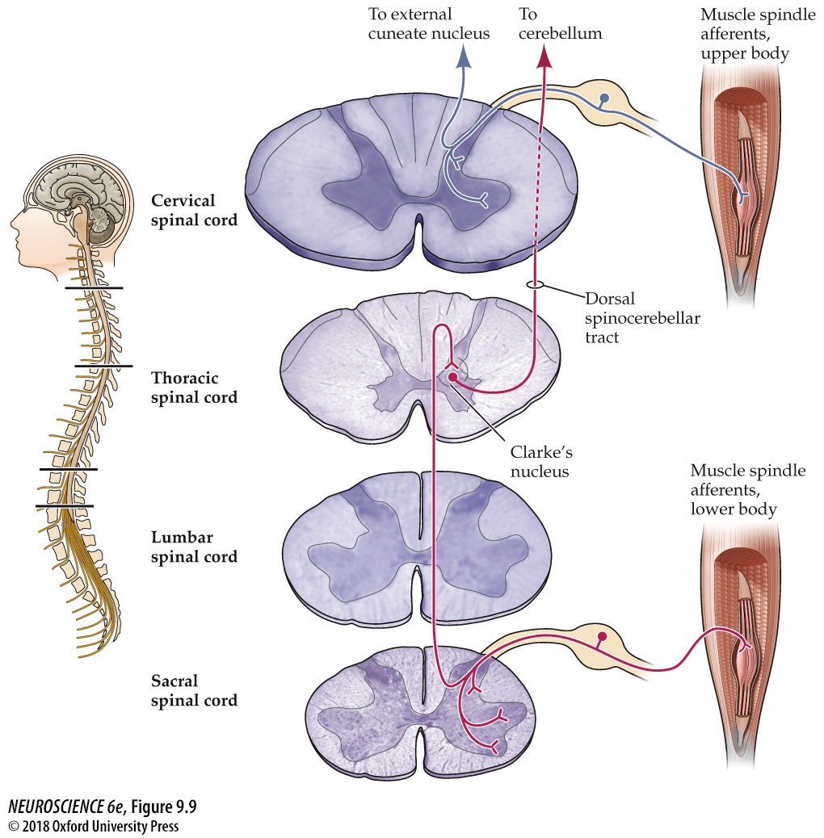
FIGURE 9.9 Proprioceptive pathways for the upper and lower body
Notes:
FIGURE 9.9 Proprioceptive pathways for the upper and lower body. Proprioceptive afferents for the lower part of the body synapse on neurons in the dorsal and ventral horn of the spinal cord and on neurons in Clarke’s nucleus. Neurons in Clarke’s nucleus send their axons via the dorsal spinocerebellar tract to the cerebellum, with a collateral to the dorsal column nuclei. Proprioceptive afferents for the upper body also have synapses in the dorsal and ventral horns, but then ascend via the dorsal column to the dorsal column nuclei; the external cuneate nucleus, in turn, relays signals to the cerebellum. Proprioceptive target neurons in the dorsal column nuclei send their axons across the midline and ascend through the medial lemniscus to the ventral posterior nucleus (see Figure 9.8).

Slide 16
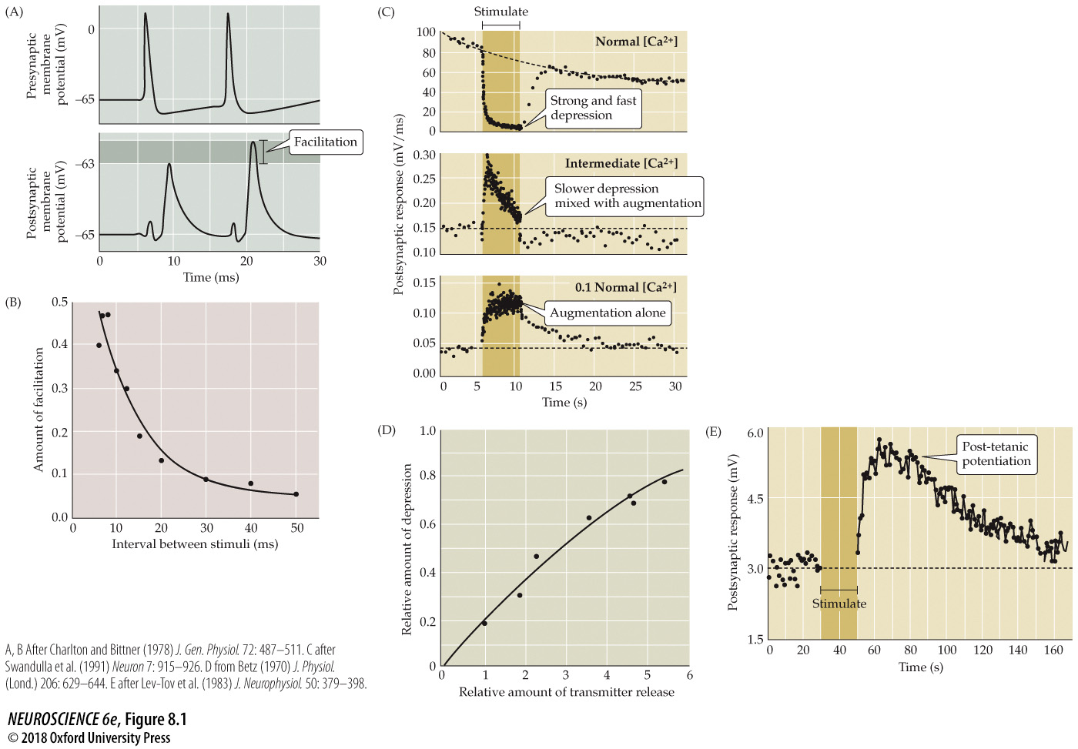
Forms of short-term synaptic plasticity
Modulation of NT release
[Ca²⁺]_{INSIDE}
Vesicle depletion
Notes:
FIGURE 8.1 Forms of short-term synaptic plasticity. (A) Facilitation at the squid giant synapse. A pair of presynaptic action potentials elicits two excitatory postsynaptic potentials (EPSPs). Because of facilitation, the second EPSP is larger than the first. (B) By varying the time interval between pairs of presynaptic action potentials, it can be seen that facilitation decays over a time course of tens of milliseconds. (C) Under typical physiological conditions, a high-frequency tetanus (darker bar) causes pronounced depression of EPSPs at the squid giant synapse (top). Lowering the external Ca²⁺ concentration to an intermediate level reduces transmitter release and causes a mixture of depression and augmentation (middle). Further reduction of the external Ca²⁺ eliminates depression, leaving only augmentation (bottom). (D) Synaptic depression at the frog neuromuscular synapse increases in proportion to the amount of transmitter released from the presynaptic terminal. (E) Application of a high-frequency tetanus (bar) to presynaptic axons innervating a spinal motor neuron causes a post-tetanic potentiation that persists for a few minutes after the tetanus ends. (A,B after Charlton and Bittner, 1978; C after Swandulla et al., 1991; D from Betz, 1970; E after Lev-Tov et al., 1983.)

Slide 17
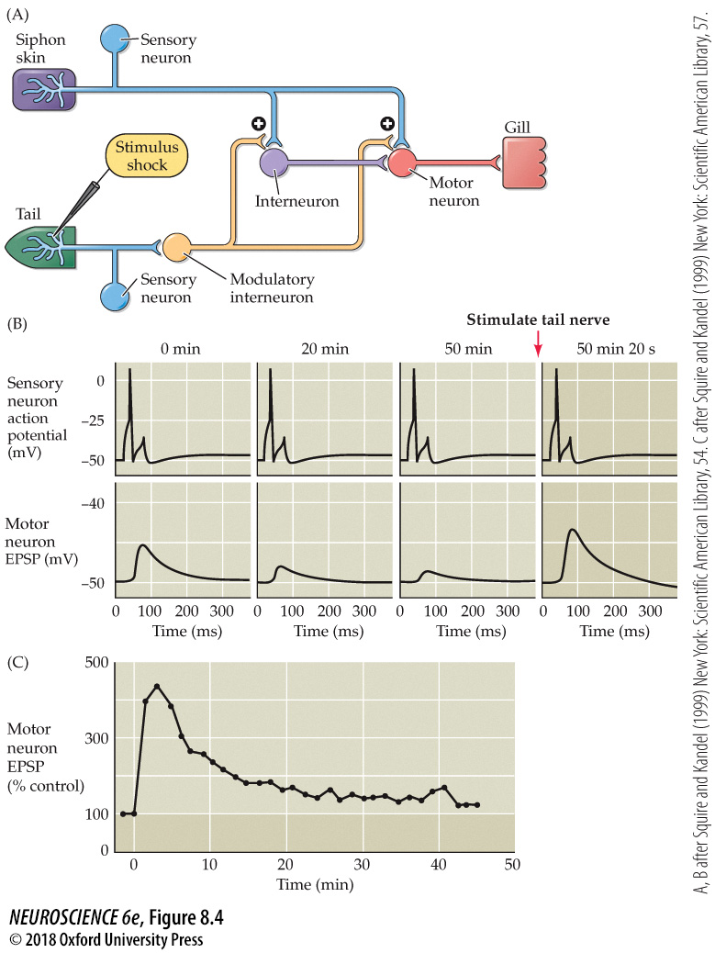
Synaptic mechanisms underlying short-term sensitization
Notes:
FIGURE 8.4 Synaptic mechanisms underlying short-term sensitization. (A) Neural circuitry involved in sensitization. Touching the siphon skin activates sensory neurons that excite interneurons and gill motor neurons, yielding a contraction of the gill muscle. A shock to the animal’s tail stimulates modulatory interneurons that alter synaptic transmission between the siphon sensory neurons and gill motor neurons, resulting in sensitization. (B) Changes in synaptic efficacy at the sensory neuron–motor neuron synapse during short-term sensitization. Prior to sensitization, activating the siphon sensory neurons causes an EPSP to occur in the gill motor neurons. Repetitive activation of this synapse causes synaptic depression, indicated by a reduction in EPSPs in motor neurons. Activation of the serotonergic modulatory interneurons enhances release of transmitter from the sensory neurons onto the motor neurons, increasing the EPSP in the motor neurons and causing the motor neurons to more strongly excite the gill muscle. (C) Time course of the serotonin-induced facilitation of transmission at the sensory–motor synapse. (After Squire and Kandel, 1999.)

Slide 18
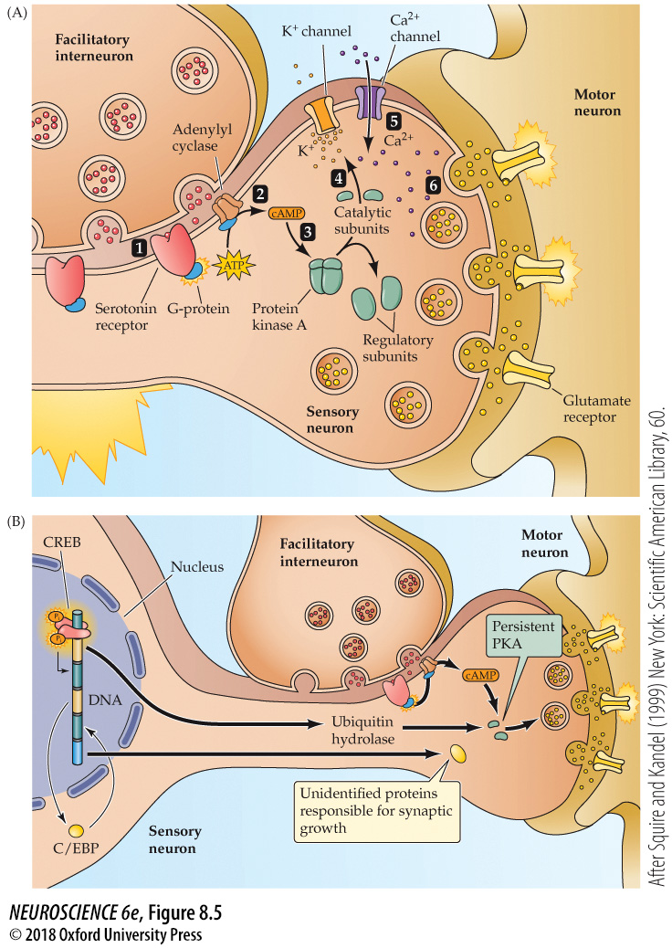
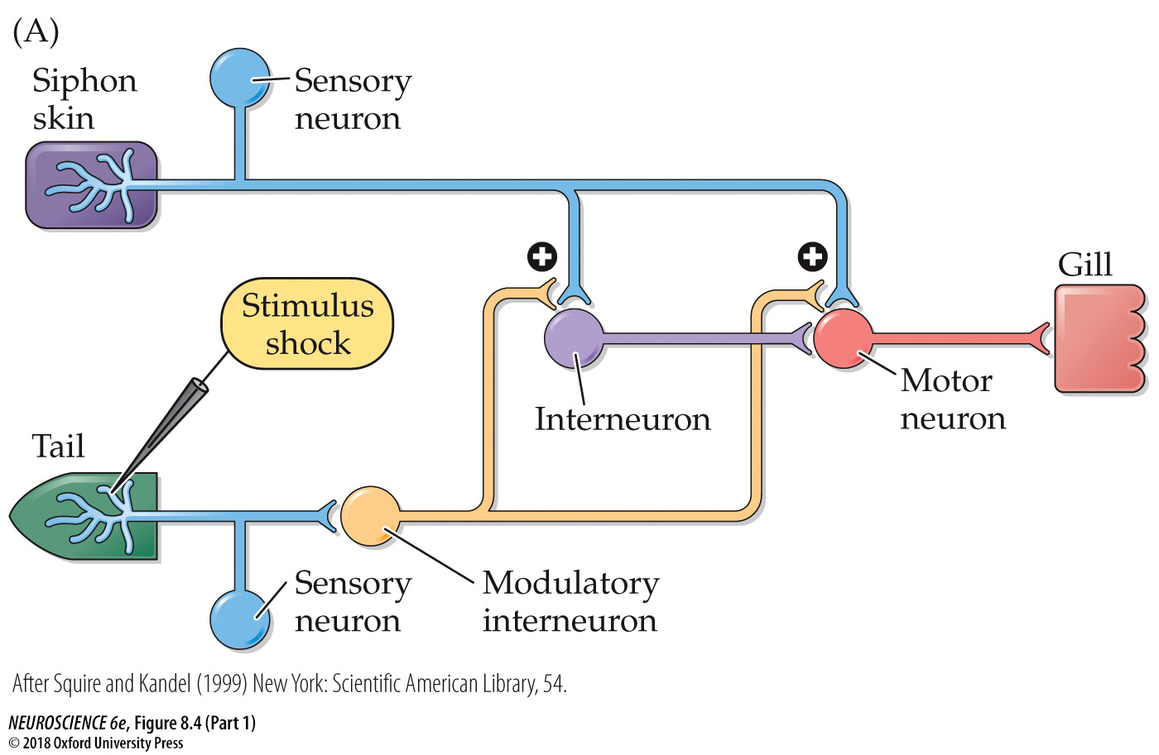
Mechanisms of presynaptic enhancement underlying behavioral sensitization
Short and long term effects
Notes:
FIGURE 8.5 Mechanisms of presynaptic enhancement underlying behavioral sensitization. (A) Short-term sensitization is due to an acute, PKA-dependent enhancement of glutamate release from the presynaptic terminals of sensory neurons. See text for explanation. (B) Long-term sensitization is due to changes in gene expression, resulting in the synthesis of proteins that change PKA activity and lead to changes in synapse growth. (After Squire and Kandel, 1999.)

Slide 19
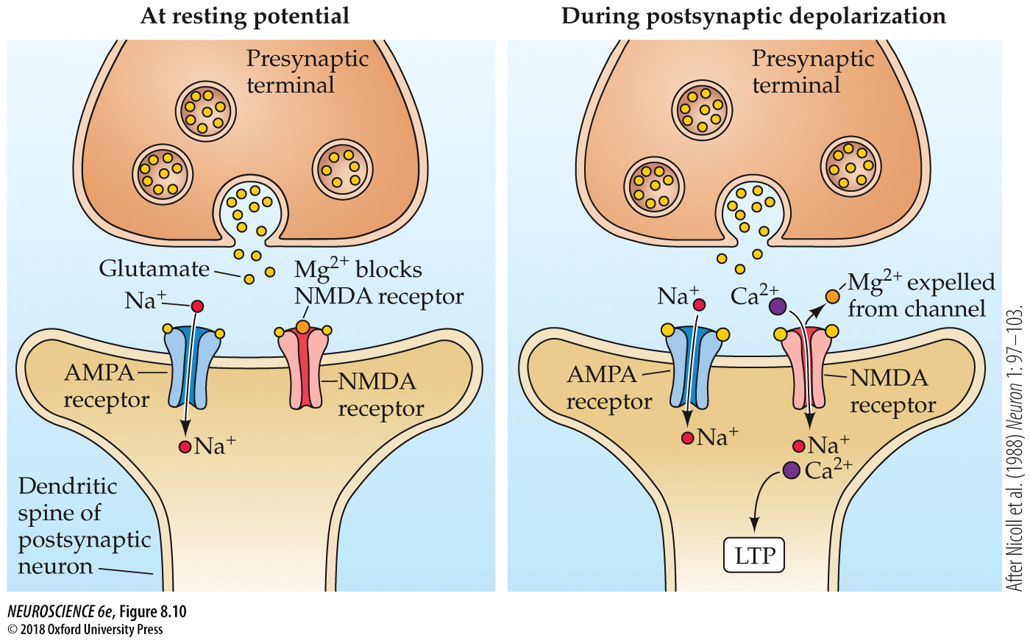
The NMDA receptor channel can open only during depolarization of the postsynaptic neuron from its normal resting potential
Notes:
FIGURE 8.10 The NMDA receptor channel can open only during depolarization of the postsynaptic neuron from its normal resting potential. Depolarization expels Mg²⁺ from the NMDA channel, allowing current to flow into the postsynaptic cell. This leads to Ca²⁺ entry, which in turn triggers LTP. (After Nicoll et al., 1988.)

